Slide 1

Experimental Design Revising Sephora’s Mobile app page to Optimize Engagement
MK 726 Group 2: kate bradford, jill cummins, ria nisar, nicole romangsuriat, lauren thin

Slide 2
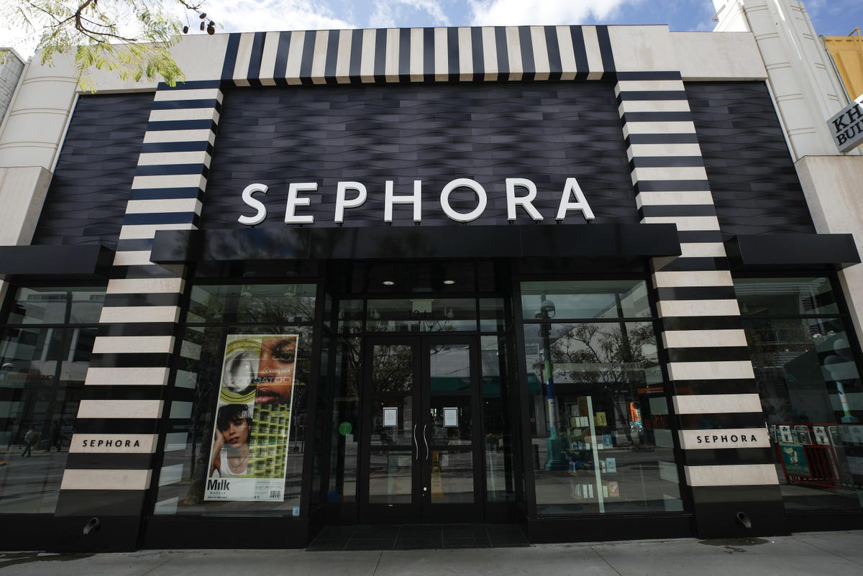
Sephora brand Introduction
Sephora is a French multinational retailer of beauty and personal care products. They are owned by LVFM and have brick and mortar stores worldwide as well as a global online presence with its website.
They have a loyalty program which is called Beauty Insider. Customers can create membership accounts by simply giving out an email and creating a password.
Members can access their accounts through the Sephora website on their computers by clicking on "sale & offers" and "beauty offers", or the website or app on their phones by clicking on the "offers" icon at the bottom of their screen.

Slide 3

Our experiment design focuses on slight changes to the Offers Page on Sephora's loyalty program.
The page currently has 7 categories, and only 4 have a permanent presence and have more than one product selection. These 4 categories are all sample sizes of existing products. We believed that adding a product/offer category would create variety and greater appeal, increase customer traffic to the offers page and increase the likelihood of offer redemptions that are often related to greater sales.
The layout of the Offers Page varies slightly when members are logging in through a browser on their computer compared to the mobile app experience.
The visual experience when viewing the website in a browser on their phones is the same as when using the app.
For the scope of this experiment, we utilize pictures of the offers page that were derived from the mobile app version.
Experiment design

Slide 4
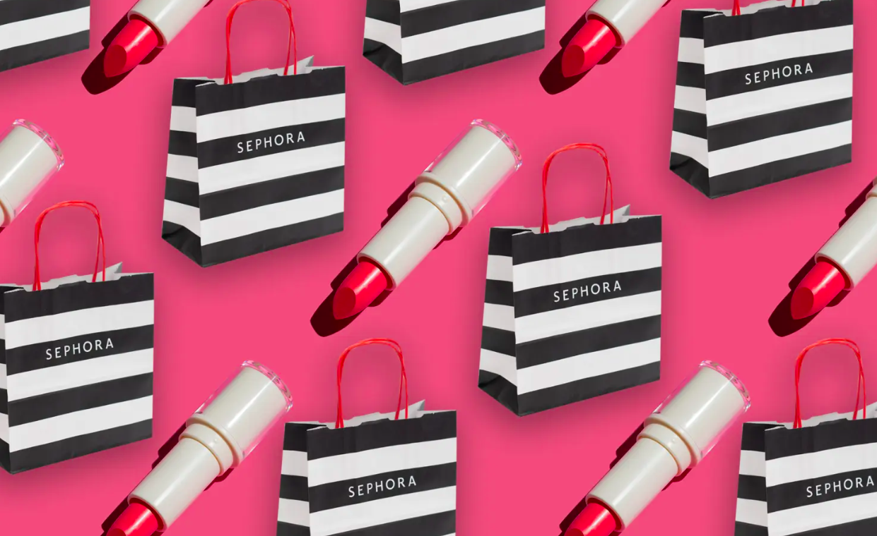
Independent Variable: During brainstorming, we thought of 2 new potential categories ("last chance," "top sellers") and considered moving one category ("savings") to the bottom of the page to highlight other categories. We chose to add the "last chance" category. Due to its low inventory that Sephora would want to pass off quickly and consumers might not want to miss out on, we believed that this would be most relevant.
Dependent Variable: In creating this new category, we believe that this would make the offers page more appealing to members, increasing click through rates and offer redemption rates.
Moderator Variable: We believe that category descriptions would work well as a moderator variable. By adding a sentence that describes each offer category and highlights its temporary nature, especially the "last chance" category, we would create a sense of urgency within consumers as we are underlining that products in the offers would run out. As a result, we believe that this could enhance the effect of the independent variable to increase offers page visits and cause members to utilize more offers
Chosen variables

Slide 5


Manipulation Checks (Likert Scale Responses)
"The loyalty program provides customers with a lot of choices and options in the offers page."
"The offers page creates a sense of urgency to buy."
"It is clear what deals are being offered."
"It is clear what products are included in the offerings."
Attention Checks
"Please select 'disagree' to this question" within questions about the offers page image
"Please select 'strongly agree' to this question" within questions about consumer reaction
Experiment checks

Slide 6

APPENDIX

Slide 7
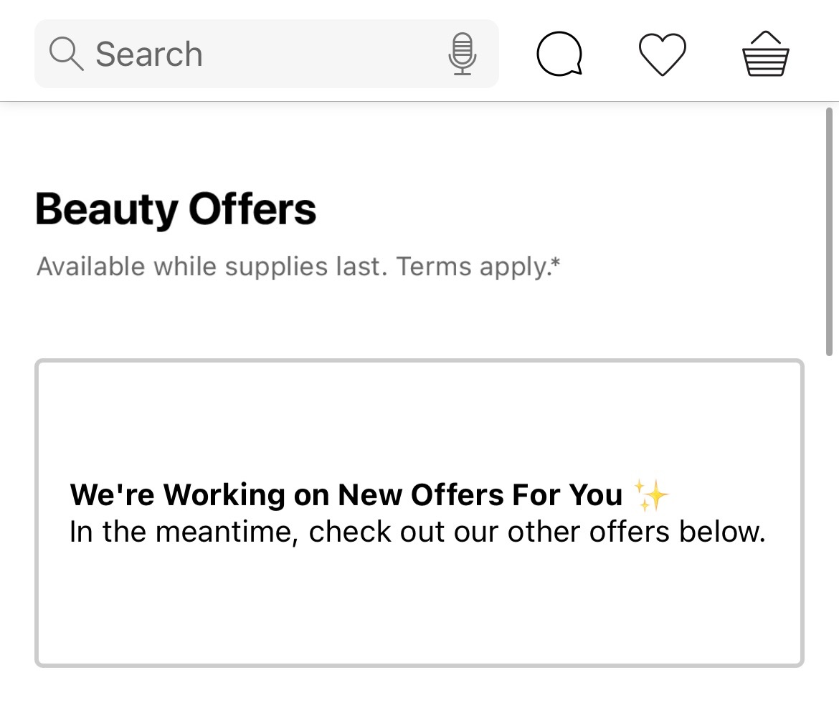
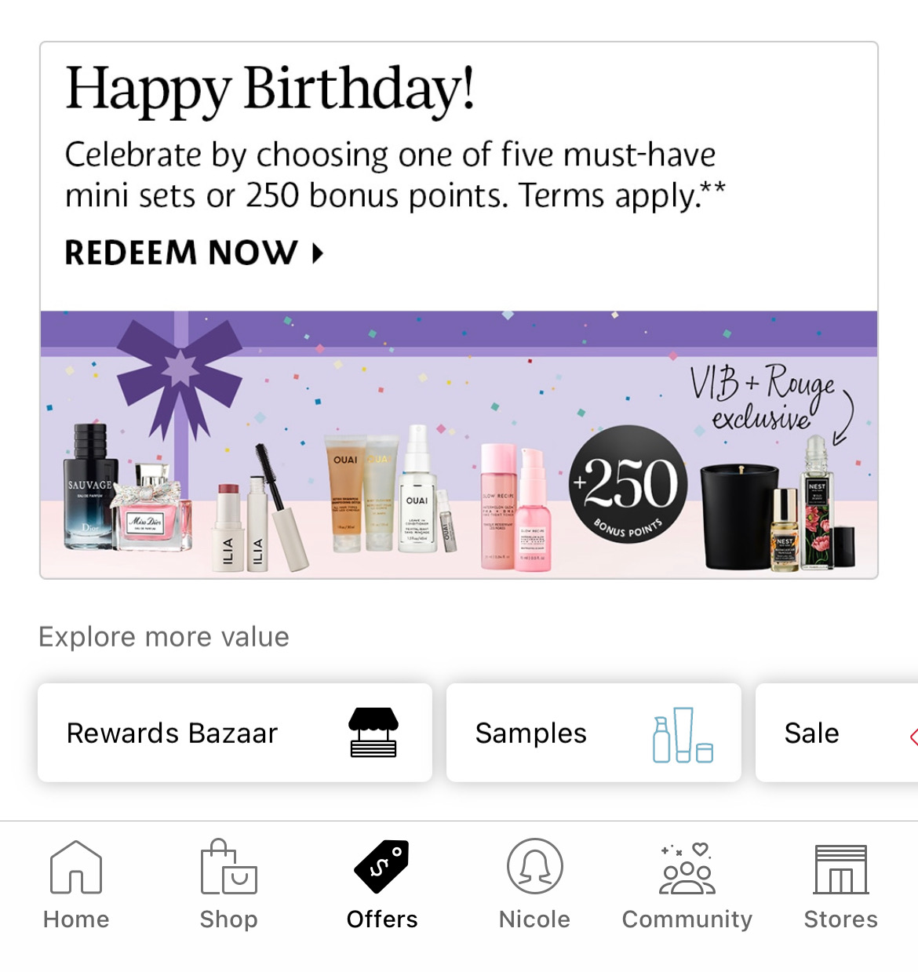
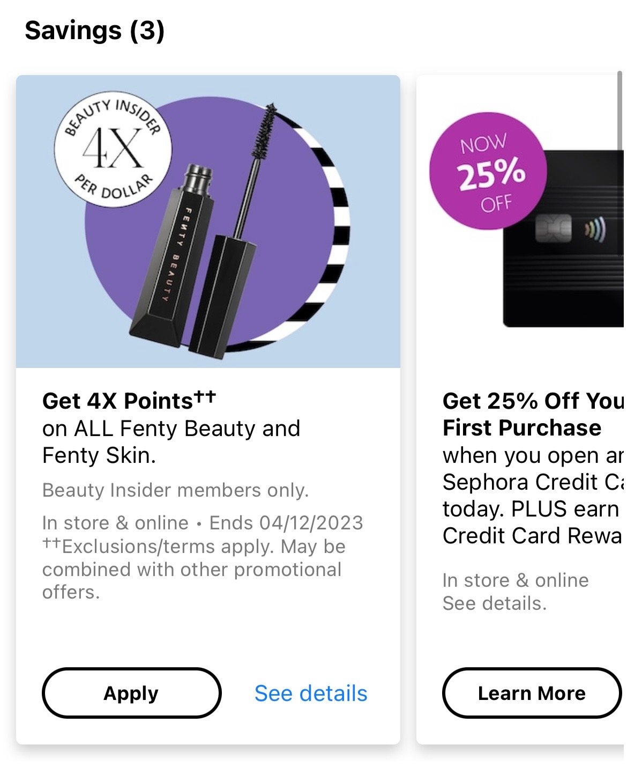
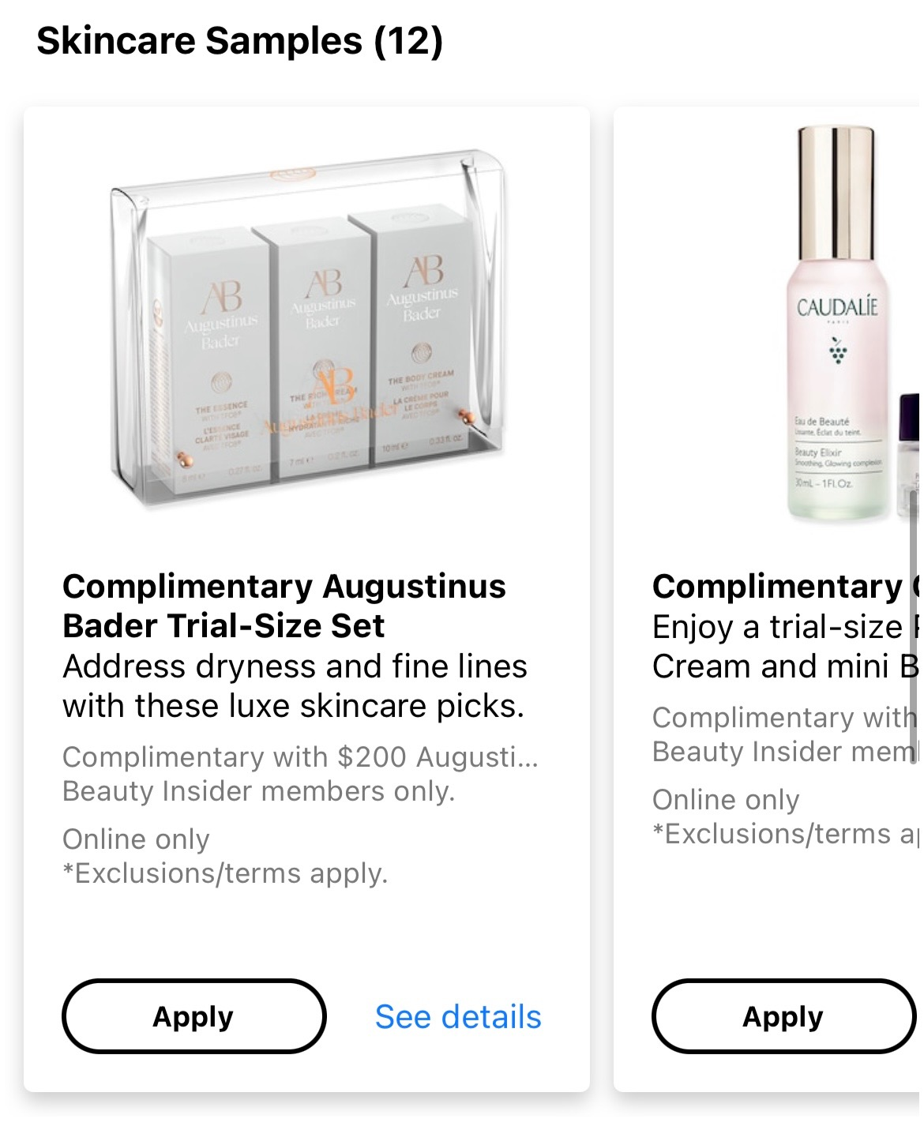
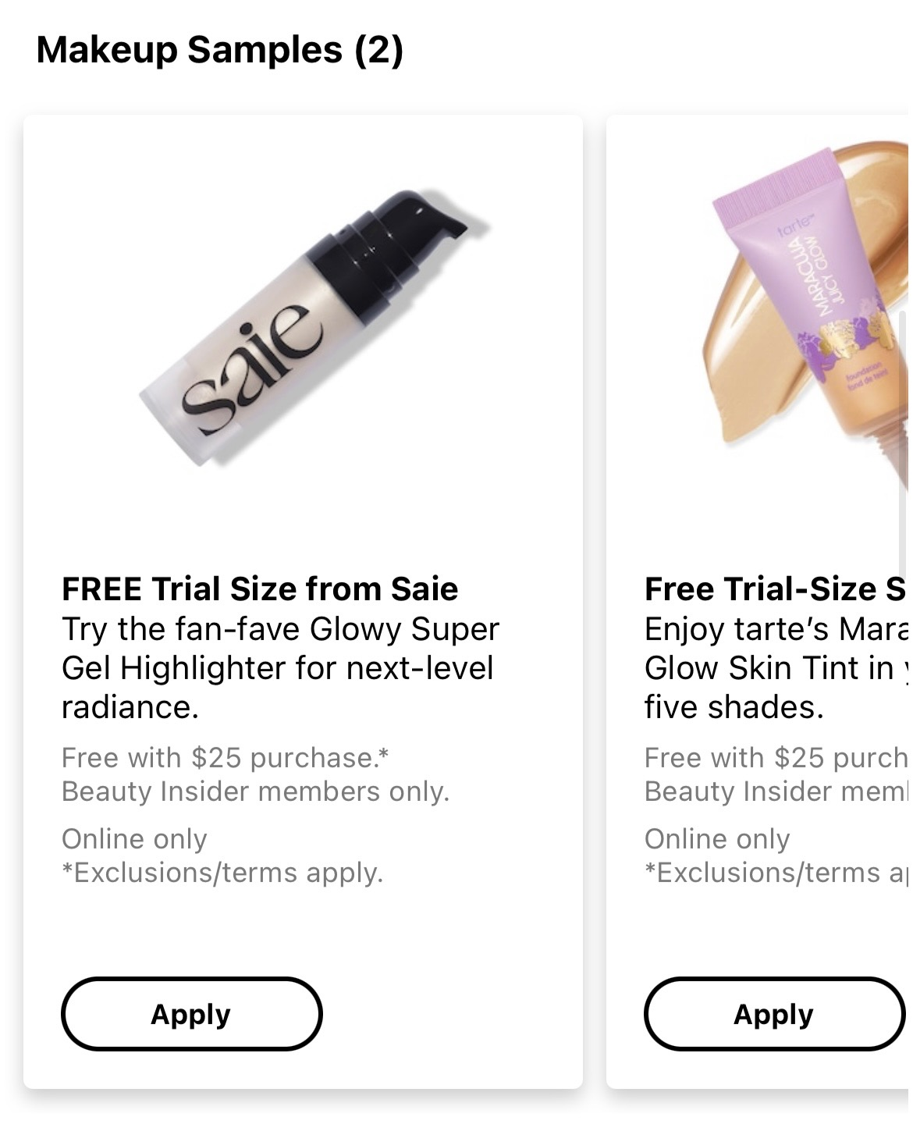
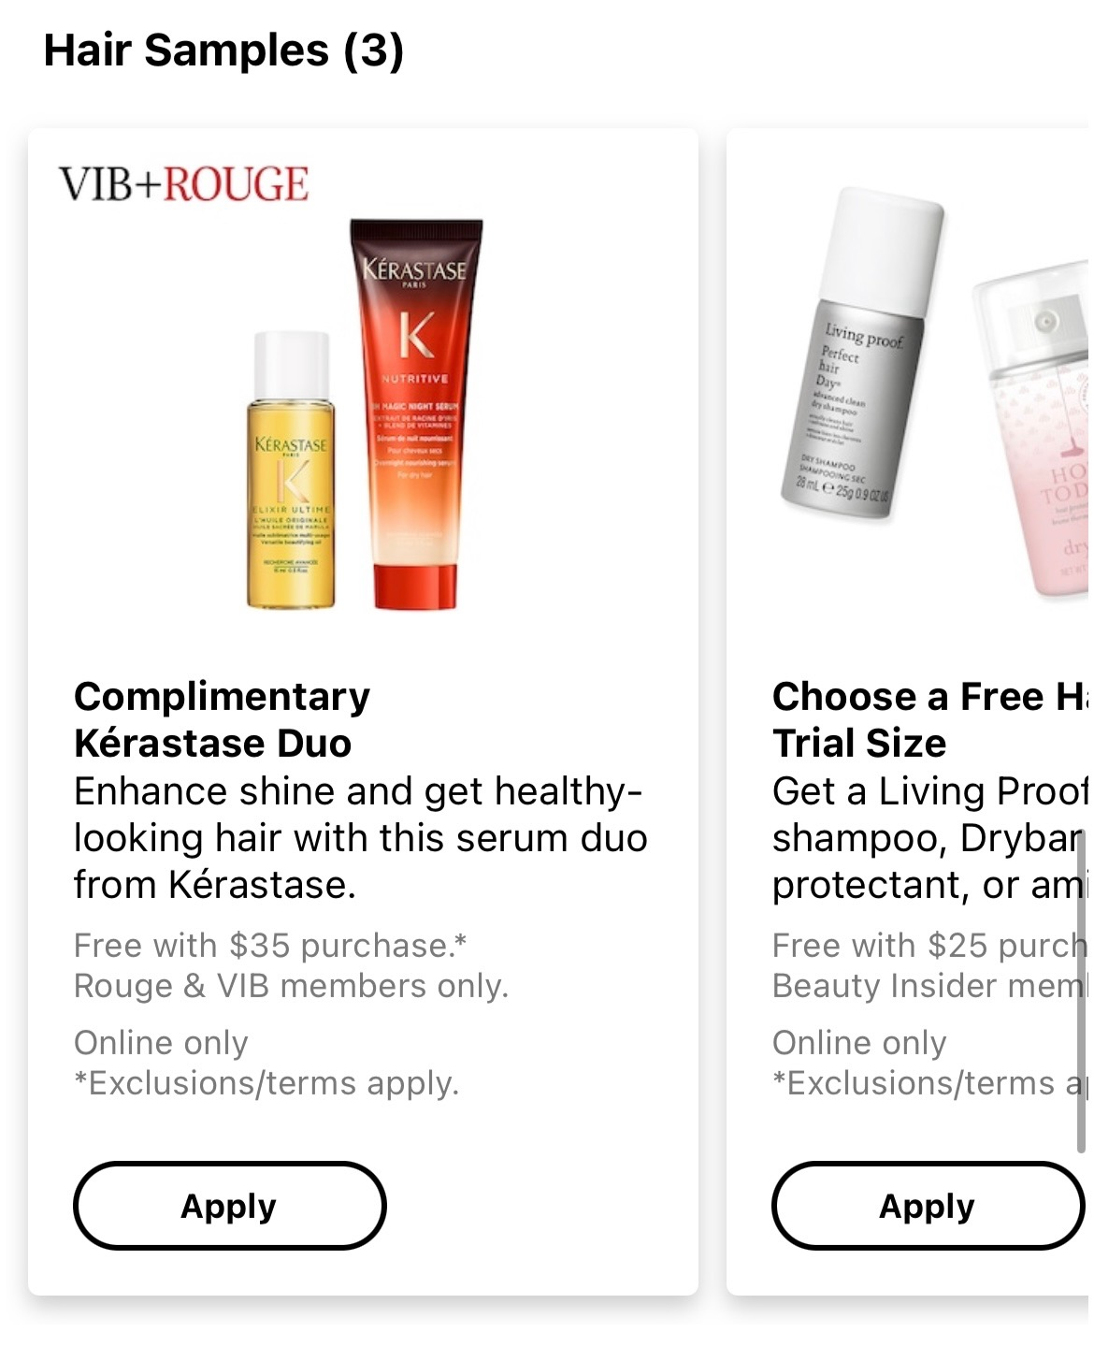
Original sephora offers page

Slide 8
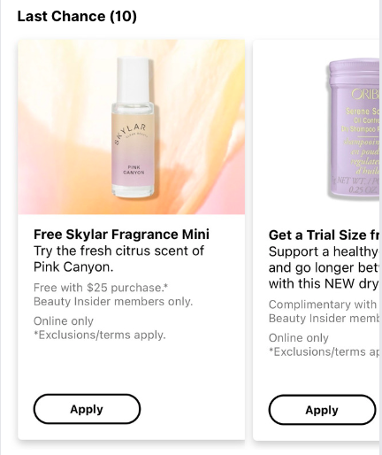
Last Chance Category
Savings: Don't miss out on our great discounts and points deals!
Last Chance: Check out these products before they run out of stock!
Makeup Samples: Grab some sample sizes of our most popular cosmetics!
Skincare Samples: Take a look at these samples of our top skincare products!
Hair Samples: Don't forget to look at these samples of our best hair care products!
Category descriptions

